Slide 1
Array , Array list and Linked Lists

Slide 2
Reference book
For Java
Required Text:
Introduction to Java Programming, Comprehensive Version, 10th Edition
By Y. Daniel Liang
Pearson Publishing, 2015
ISBN#: 978-0-13-376131-3
Technology requirements: Any IDE and Java compiler.

Slide 3
Overview of Lecture 1
Data Structure - The logical or mathematical model of a particular organization of data is called a data structure. Types of Data Structure:
1. Linear Data Structure
Example: Arrays, Linked Lists, Stacks, Queues
2. Nonlinear Data Structure
Example: Trees, Graphs.

Slide 4
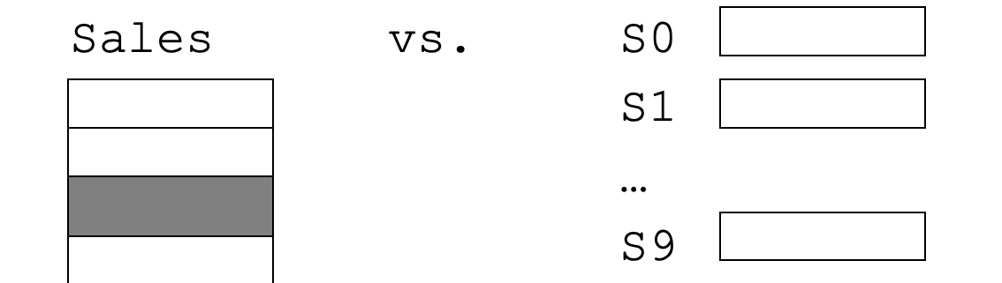
Array
A Data Structure is a grouping of data items in memory under one name
When data items same type, can use Array
Using an array, we can set aside a block of memory giving the block a name:

Slide 5
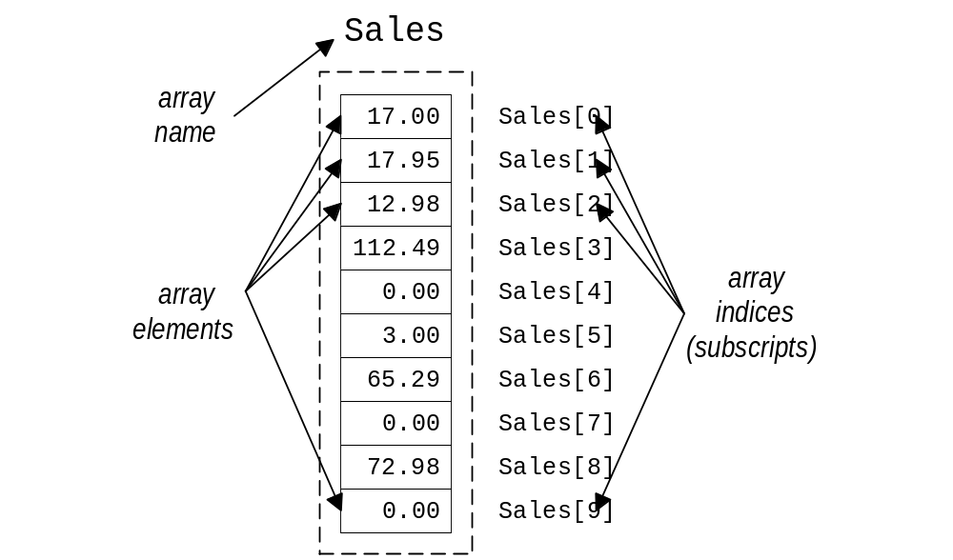
Parts of an Array

Slide 6
Accessing Array Elements
Requires
  array name,
  subscript labeling individual element
Syntax: name[subscript]
Example
  Sales[5] refers to the sales totals for employee 5
  Sales[5] can be treated like any float variable:
    Sales[5] = 123.45;
    printf(“Sales for employee 5: $%7.2f\n”,Sales[5]);

Slide 7
Invalid Array Usage
Example:
  float Sales[10];
Invalid array assignments:
  Sales = 17.50; /* missing subscript */
  Sales[-1] = 17.50; /* subscript out of range */
  Sales[10] = 17.50; /* subscript out of range */
  Sales[7.0] = 17.50; /* subscript wrong type */
  Sales[‘a’] = 17.50; /* subscript wrong type */
  Sales[7] = ‘A’; /* data is wrong type */
Conversion will still occur:
  Sales[7] = 17; /* 17 converted to float */

Slide 8
Array Initialization
Arrays may be initialized, but we need to give a list of values
Language specific [ initialization is different in different language ]
Syntax:
  Type Name[Size] =
  { value0, value1, value2, …, valueSize-1 };
  value0 initializes Name[0], value1 initializes Name[1], etc.
  values must be of appropriate type (though automatic casting will occur)

Slide 9
Array Initialization
Example:
  int NumDays[12] = { 31, 28, 31, 30, 31, 30, 31, 31, 30, 31, 30, 31 }; /* Jan is 0, Feb is 1, etc. */
  int NumDays[13] = { 0, 31, 28, 31, 30, 31, 30, 31, 31, 30, 31, 30, 31 }; /* Jan is 1, Feb is 2, */
Note:
  if too few values provided, remaining array members not initialized
  if too many values provided, a syntax error or warning may occur (extra values ignored)

Slide 10
Array Implementation in Java
public class ArrayImplementation {
public static void main(String[] args) {
// Creating an array of integers
int[] numbers = new int[5];
// Initializing array elements
numbers[0] = 10;
numbers[1] = 20;
numbers[2] = 30;
numbers[3] = 40;
numbers[4] = 50;

Slide 11
// Accessing and printing array elements
System.out.println("Array elements:");
for (int i = 0; i < numbers.length; i++) {
System.out.println("numbers[" + i + "] = " + numbers[i]);
}
// Updating an array element
numbers[2] = 35;

Slide 12
// Accessing and printing the updated array
System.out.println("\nUpdated array elements:");
for (int i = 0; i < numbers.length; i++) {
System.out.println("numbers[" + i + "] = " + numbers[i]);
}

Slide 13
// Finding the sum of array elements
int sum = 0;
for (int i = 0; i < numbers.length; i++) {
sum += numbers[i];
}
System.out.println("\nSum of array elements: " + sum);
}
}

Slide 14
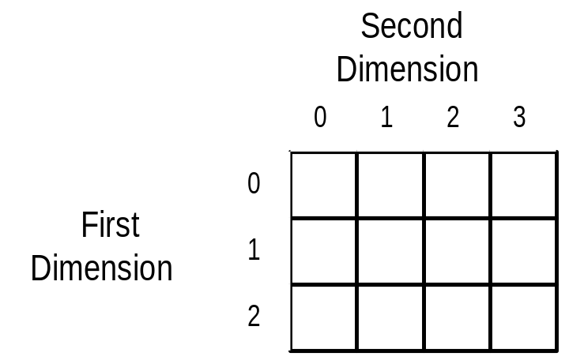
2-Dimensional Array Declaration
Syntax: BaseType Name[IntLit1][IntLit2];
Examples:
  int Scores[100][10]; /* 100 x 10 set of scores */
  char Maze[5][5]; /* 5 x 5 matrix of chars for Maze */
  float FloatM[3][4]; /* 3 x 4 matrix of floats */

Slide 15
2D Array Element Reference
Syntax: Name[intExpr1][intExpr2]
Expressions are used for the two dimensions in that order
Values used as subscripts must be legal for each dimension
Each location referenced can be treated as variable of that type
Example: Maze[3][2] is a character

Slide 16
Multi-Dimensional Array Declaration
Syntax:
  BaseType Name[IntLit1][IntLit2][IntLit3]...;
One constant for each dimension
Can have as many dimensions as desired
Examples:
  int Ppoints[100][256][256]; /* 3D array */
  float TimeVolData[100][256][256][256];
  /* 4D array */

Slide 17
Multi-Dim Array Reference
To refer to an element of multi-dimensional array use one expression for each dimension
  syntax:
    Name[Expr1][Expr2][Expr3] /* 3D */
    Name[Expr1][Expr2][Expr3][Expr4] /* 4D */
    etc.
First expression - first dimension, 2nd expression - 2nd dimension, etc.

Slide 18
Java Collection Framework hierarchy
A collection is a container object that holds a group of objects, often referred to as elements. The Java Collections Framework supports three types of collections, named lists, sets, and maps.

Slide 19
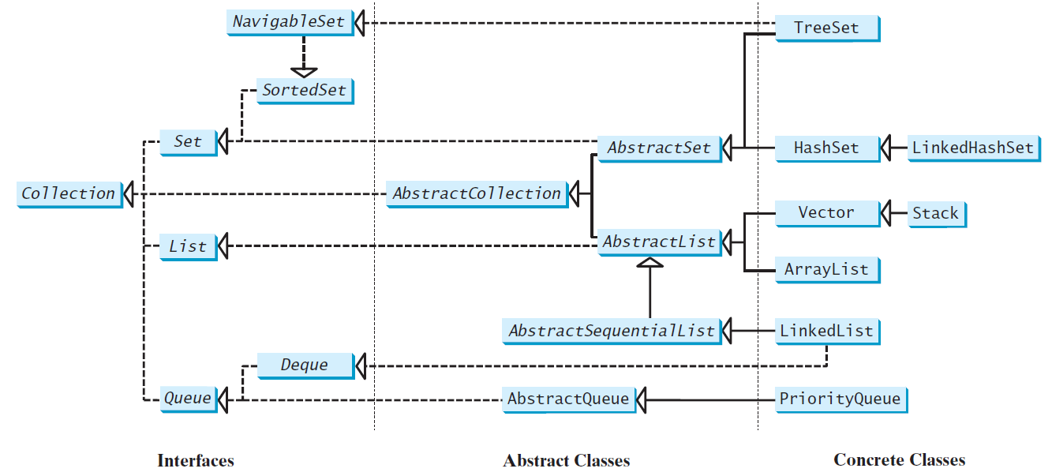
Java Collection Framework hierarchy, cont.
Set and List are subinterfaces of Collection.

Slide 20
List Data Structure
A list is a popular data structure to store data in sequential order. For example, a list of students, a list of available rooms, a list of cities, and a list of books, etc. can be stored using lists.
The common operations on a list are usually the following:
Retrieve an element from the list
Insert a new element to the list
Delete an element from the list
Find how many elements are in the list
Find if an element is in the list
Check if the list is empty
Others...

Slide 21
Two Ways to Implement Lists
There are two ways to implement a list.
Array: The array is dynamically created. If the capacity of the array is exceeded, create a new larger array and copy all the elements from the current array to the new array.
Linked-list: A linked structure consists of nodes. Each node is dynamically created to hold a data element. All the nodes are linked together to form the list.

Slide 22
Array List
Array is a fixed-size data structure. Once an array is created, its size cannot be changed. Nevertheless, you can still use array to implement dynamic data structures. The trick is to create a new larger array to replace the current array if the current array cannot hold new elements in the list.
Initially, an array, say data of Object[] type, is created with a default size. When inserting a new element into the array, first ensure there is enough room in the array. If not, create a new array with the size as twice as the current one. Copy the elements from the current array to the new array. The new array now becomes the current array.

Slide 23

Array List Illustration
Insert Operations: (insert to end of the list) Insert 5;
Insert 51;
Insert 12;
Insert 13;
Insert 1;

Slide 24
Insertion at Specific Index
Before inserting a new element at a specified index, shift all the elements after the index to the right and increase the list size by 1.
Before inserting
e at insertion point i
0 1
…
i i+1
…
k-1
k
e₀ | e₁ | … | ei-1 | e_{i} | ei+1 | … | ek-1 | e_{k}
data.length -1
e
Insertion point
…shift…
After inserting
e at insertion point i, list size is incremented by 1
0 1
…
i i+1 i+2
…
k
k+1
e₀ | e₁ | … | ei-1 | e | e_{i} | ei+1 | … | ek-1 | e_{k}
e inserted here
data.length -1

Slide 25
Deletion from Specific Index
To remove an element at a specified index, shift all the elements after the index to the left by one position and decrease the list size by 1.
Before deleting the element at index i
0 1
…
i i+1
…
k-1 k
e₀
e₁
…
^{e}i-1
e_{i}
^{e}i+1
…
^{e}k-1
e_{k}
Delete this element
…shift…
d ata.length -1
After deleting the element, list size is decremented by 1
0 1
…
i
…
k-2 k-1
e₀
e₁
…
^{e}i-1
^{e}i+1
…
^{e}k -1
e_{k}
data.length -1

Slide 26
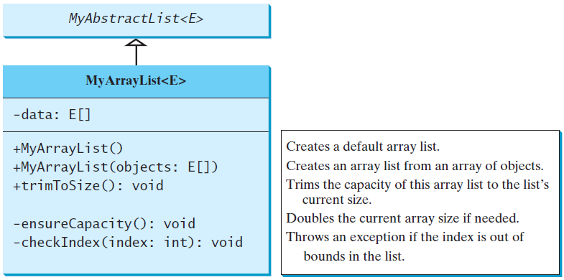
Implementing MyArrayList

Slide 27
Array vs Array List
import java.util.ArrayList;
import java.util.Arrays;
public class ArrayVsArrayList {
public static void main(String[] args) {
//[0][1][2][3]

Slide 28
// Create
String[] friendsArray = {"John", "Chris", "Eric", "Luke"};
//or
String[] friendsArray2 = new String[4];
ArrayList<String> friendsArrayList =
new ArrayList<>(Arrays.asList("John", "Chris", "Eric", "Luke"));
//or
ArrayList<String> friendsArrayList2 = new ArrayList<>();

Slide 29
//Get element
System.out.println(friendsArray[1]);
System.out.println(friendsArrayList.get(1));
//Get size
System.out.println(friendsArray.length);
System.out.println(friendsArrayList.size());

Slide 30
//Add an element
//You can't do this with Arrays :(
friendsArrayList.add("Mitch");
System.out.println(friendsArrayList.get(4));
//Set an element
friendsArray[0] = "Carl";
System.out.println(friendsArray[0]);
friendsArrayList.set(0, "Carl");
System.out.println(friendsArrayList.get(0));

Slide 31
//Remove an element
// Can't do this with arrays :(
friendsArrayList.remove("Chris");
System.out.println(friendsArrayList.get(1));
//Print
//Doesn't work well for Arrays! Must loop through all elements instead.
System.out.println(friendsArray);
System.out.println(friendsArrayList);
}
}

Slide 32
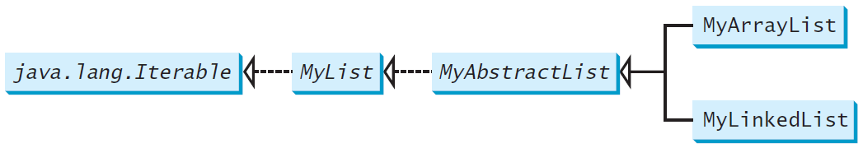
Design of ArrayList and LinkedList
For convenience, let’s name these two classes: MyArrayList and MyLinkedList. These two classes have common operations, but different data fields. The common operations can be generalized in an interface or an abstract class. A good strategy is to combine the virtues of interfaces and abstract classes by providing both interface and abstract class in the design so the user can use either the interface or the abstract class whichever is convenient. Such an abstract class is known as a convenience class.

Slide 33
Why Linked List?
Since MyArrayList is implemented using an array, the methods get(int index) and set(int index, Object o) for accessing and modifying an element through an index and the add(Object o) for adding an element at the end of the list are efficient. However, the methods add(int index, Object o) and remove(int index) are inefficient because it requires shifting potentially a large number of elements. You can use a linked structure to implement a list to improve efficiency for adding and removing an element anywhere in a list.

Slide 34
Content: Linked List
Introduction to Linked list,
1. Representation of linked list in memory,
2. Traversing,
3. Searching in Unsorted linked list,
4. Overflow and Underflow,
5. Inserting at the beginning of a list,
6. deleting node following a given Node.

Slide 35
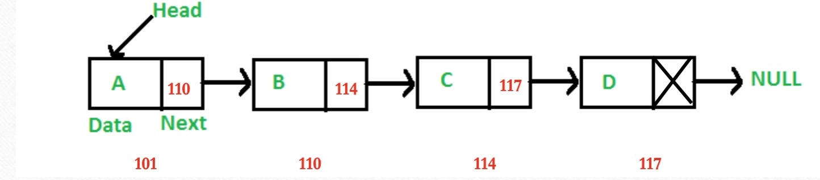
Introduction to Linked list
• Like arrays, Linked List is a linear data structure.
• Unlike arrays, linked list elements are not stored at a contiguous location;
• the elements are linked using pointers.

Slide 36
Example
In a system, if we maintain a sorted list of IDs in an array id[]. id[] = [1000, 1010, 1050, 2000, 2040].
And if we want to insert a new ID 1005, then to maintain the sorted order, we have to move all the elements after 1000 (excluding 1000).
Deletion is also expensive with arrays until unless some special techniques are used. For example, to delete 1010 in id[], everything after 1010 has to be moved.

Slide 37
Representations
A linked list is represented by a pointer to the first node of the linked list. The first node is called the head. If the linked list is empty, then the value of the head is NULL.
Each node in a list consists of at least two parts:
1) data 2) Pointer (Or Reference) to the next node In C, we can represent a node using structures.

Slide 38
Representations
Let LIST be a linked list. Then LIST will be maintained in memory specified as follows. First of all, LIST requires two linear arrays we will call them here INFO and LINK- such that INFO[K] and LINK[K] contain, respectively, the information part and the nextpointer field of a node LIST. As noted above LIST also requires a variable name- such as START. START contains the location of the beginning of the list, and a nextpointer sentinel -denoted by NULL- which indicate the end of the list. Since the subscripts of the array INFO and LINK are usually positive, we will choose NULL=0.

Slide 39
The following example of linked list indicate that the nodes of a list need not occupy adjacent elements in the array INFO and LINK, and that more than one list may be maintained in the same linear array INFO and LINK. However, each list must have its own pointer variable giving the location of its first node.

Slide 40
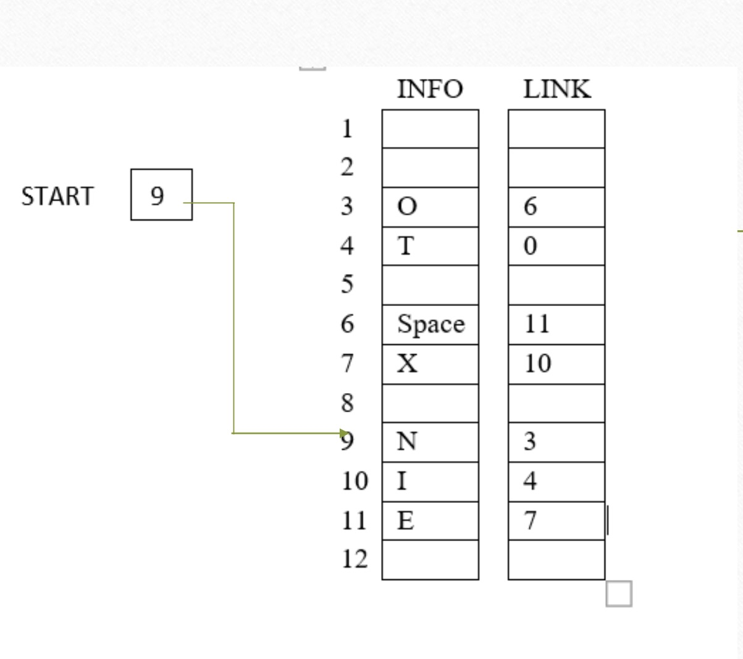
Example

Slide 41
Representation
Previous picture is of linked list in memory where each node of the list contains a single character. We can obtain the actual list of characters as follows.
Algorithm :
START= 9, so INFO[9]=N is the first character. LINK[9]=3, so INFO[3]=O is the second character. LINK[3]=6, so INFO[6]= (Blank) is the third character. LINK[6]=11, so INFO[11]=E is the fourth character. LINK[11]=7, so INFO[7]=X is the fifth character.
LINK[7]=10, so INFO[10]=I is the sixth character. LINK[10]=4, so INFO[4]=T is the seventh character. LINK[4]=0, the NULL value, so the List has ended.
In other words, NO EXIT is the character string.

Slide 42
Types of Link List
• Following are the various types of linked list.
• Simple Linked List − Item navigation is forward only.
• Doubly Linked List − Items can be navigated forward and backward.
• Circular Linked List − Last item contains link of the first element as next and the first element has a link to the last element as previous.

Slide 43
Simple Linked List

Slide 44
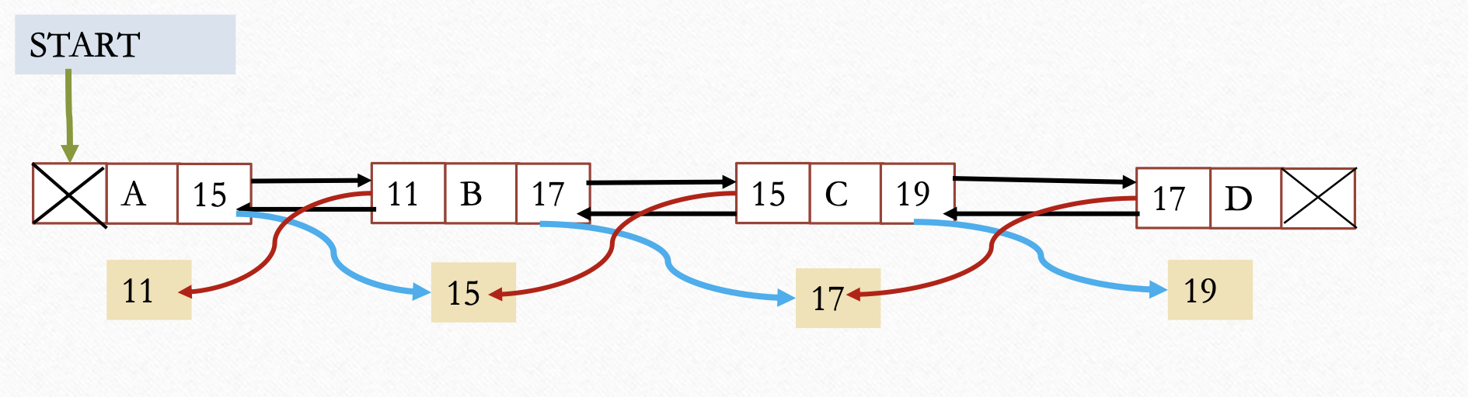
Doubly Linked List

Slide 45
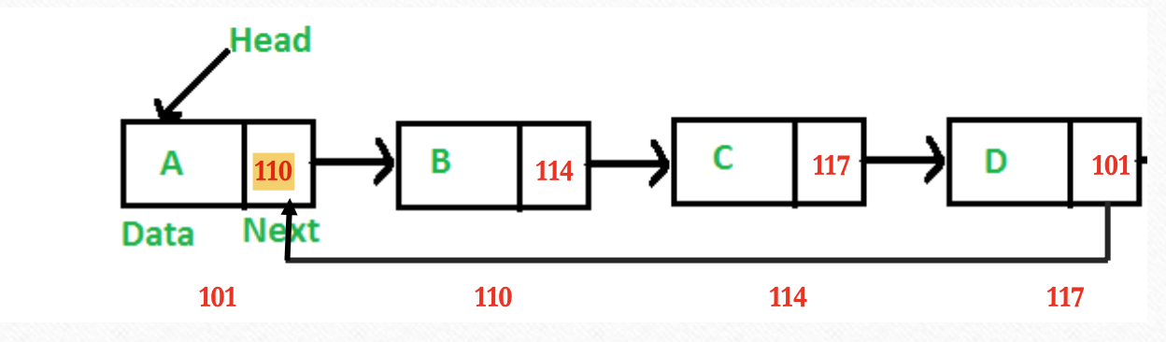
Circular Linked List (Simple)

Slide 46
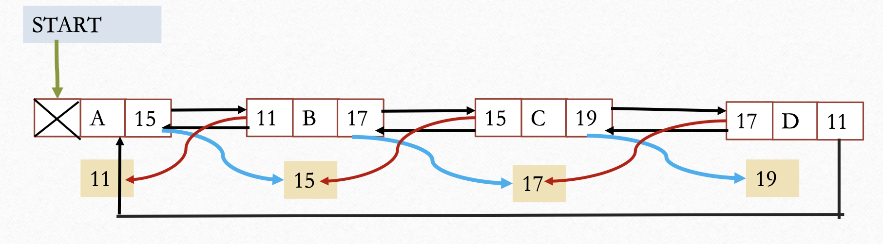
Circular Linked List (Double)

Slide 47
Simple Linked List in java
class Node {
int data;
Node next;
public Node(int data) {
this.data = data;
this.next = null;
}
}

Slide 48
class LinkedList {
Node head;
public LinkedList() {
head = null;
}

Slide 49
public void add(int data) {
Node newNode = new Node(data);
if (head == null) {
head = newNode;
} else {
Node current = head;
while (current.next != null) {
current = current.next;
}
current.next = newNode;
}
}

Slide 50
public void delete(int data) {
if (head == null) {
return;
}
if (head.data == data) {
head = head.next;
return;
}

Slide 51
Node current = head;
while (current.next != null && current.next.data != data) {
current = current.next;
}
if (current.next != null) {
current.next = current.next.next;
}
}

Slide 52
public void display() {
Node current = head;
while (current != null) {
System.out.print(current.data + " ");
current = current.next;
}
System.out.println();
}
}

Slide 53
public class Main {
public static void main(String[] args) {
LinkedList list = new LinkedList();
list.add(1);
list.add(2);
list.add(3);
list.add(4);

Slide 54
System.out.println("Original List:");
list.display();
list.delete(2);
System.out.println("After deleting 2:");
list.display();
}
}

Slide 55
In this code, the Node class represents the individual elements of the linked list, and the LinkedList class contains the methods for adding, deleting, and displaying elements. The add method adds a new node with the given data to the end of the list, and the delete method removes the node with the specified data. The display method prints the contents of the linked list. The Main class demonstrates how to use the linked list by adding elements and deleting a specific element.

Slide 56
Traversing
A linked list is a linear data structure that needs to be traversed starting from the head node until the end of the list. Unlike arrays, where random access is possible, linked list requires access to its nodes through sequential traversal. Traversing a linked list is important in many applications. For example, we may want to print a list or search for a specific node in the list. Or we may want to perform an advanced operation on the list as we traverse the list. The algorithm for traversing a list is fairly trivial.

Slide 57
Traversing
Start with the head of the list. Access the content of the head node if it is not null. Then go to the next node(if exists) and access the node information
Continue until no more nodes (that is, you have reached the last node)
Let LIST be a linked list in memory stored in linear array INFO and LINK with START pointing to the first element and NULL indicating the end of LIST. Suppose we want to traverse LIST in order to Process each node exactly once. This section presents an algorithm that does so and then uses the algorithm in some applications.

Slide 58
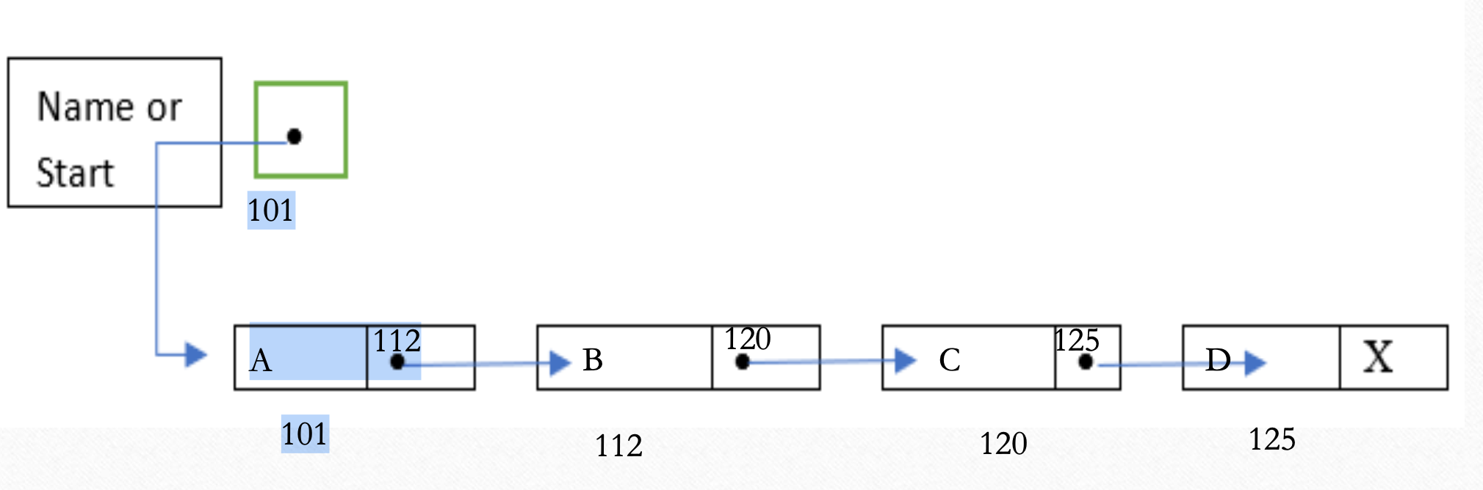

Slide 59
Algorithm
Algorithm:
1. Set PTR:=START.[Initializes pointer PTR]
2. Repeat Step 3 and 4 while PTR≠ NULL.
3. Apply PROCESS to INFO[PTR].
4. Set PTR:= LINK[PTR]. [PTR now points to the next node.]
[End of Step 2 loop.]
5. Exit.

Slide 60
Algorithm details
Initialize PTR or START.
Then process INFO[PTR], the information at the first node.
Update PTR by the assignment PTR:=LINK[PTR], so that PTR points to the second node.
Then Process INFO[PTR], the information at the second node.
Again update PTR by the assignment operator PTR:=LINK[PTR], and then process INFO[PTR], the information at the third node.
And so on. Continue until PTR=NULL, which signals the end of the list.

Slide 61
Searching Unsorted linked list
Let LIST be a linked list in memory which is not sorted, then one searches for ITEM in LIST by traversing through the list using a pointer variable PTR and comparing ITEM with the contents INFO[PTR] of each node, one by one, of LIST. Before we update the pointer PTR by PTR:=LINK[PTR]
We require two tests. First we have to check to see whether we have reached the end of list i.e.
PTR= NULL
Then we check to see whether
INFO[PTR]=ITEM

Slide 62
Algorithm:
SEARCH (INFO, LINK, START, ITEM, LOC)
LIST is a linked list in memory. This algorithm finds the location LOC of the node where ITEM first appear in LIST, or set LOC=NULL.
set PTR:=START.
Repeat step 3 while PTR ≠ NULL:
If ITEM =INFO[PTR], then: Set LOC:=PTR, and Exit.
Else:
Set PTR:=LINK[PTR].[PTR now points to the next node.]
[End of IF structure]
[End of step 2 loop]
[Search is unsuccessful.] set LOC:=NULL. Exit.

Slide 63
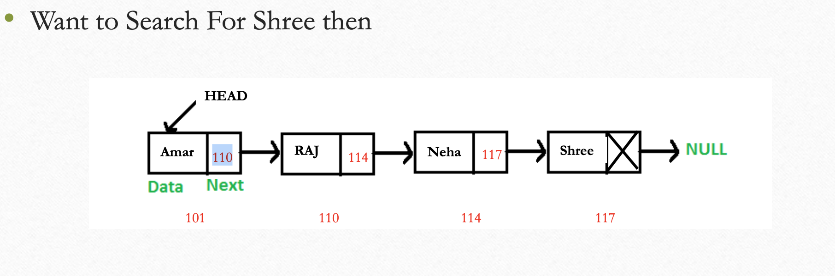

Slide 64
Overflow
Sometimes new data are to be inserted into a data structure but
there is no available space, i.e. the free-storage list is empty. This situation is usually called overflow.
The programmer may handle overflow by printing the message OVERFLOW.
• In such a case, the programmer may then modify the program by adding space to the underlying arrays.
• Observe that overflow will occur with our linked lists when AVAIL=NULL and there is an insertion.

Slide 65
UNDERFLOW
The term underflow refers to the situation where one wants to delete data from a data structure that is empty.
The programmer may handle underflow by printing the message UNDERFLOW.
Observe that underflow will occur with our linked when START = NULL and there is a deletion.

Slide 66
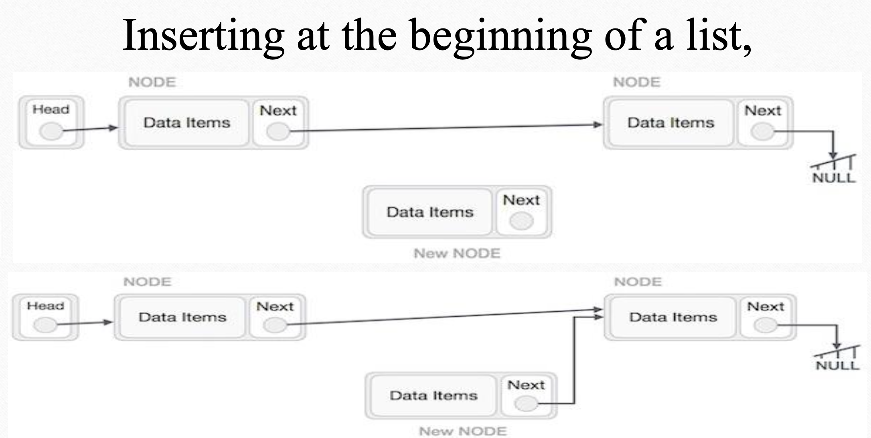

Slide 67
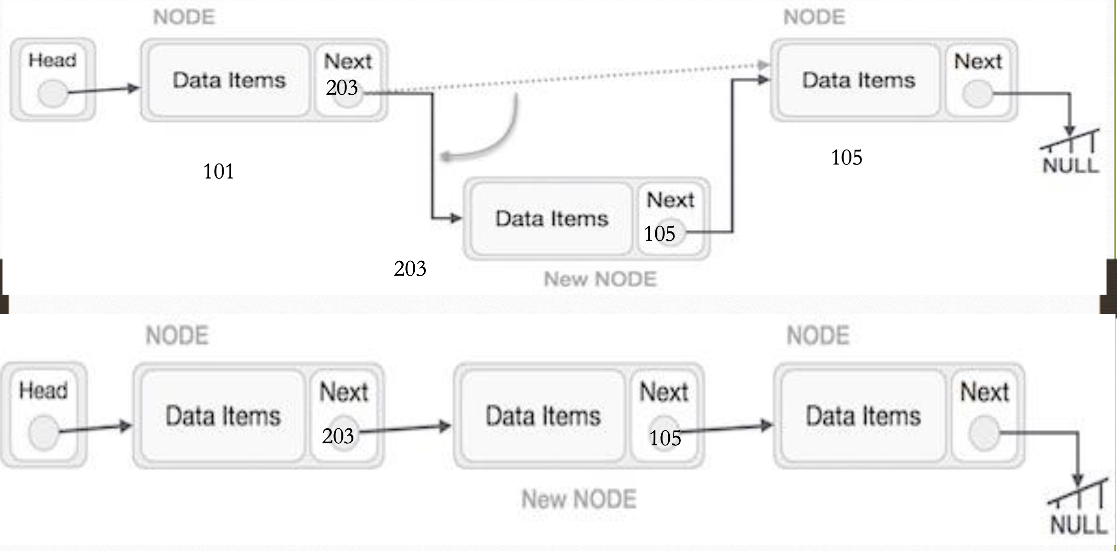

Slide 68
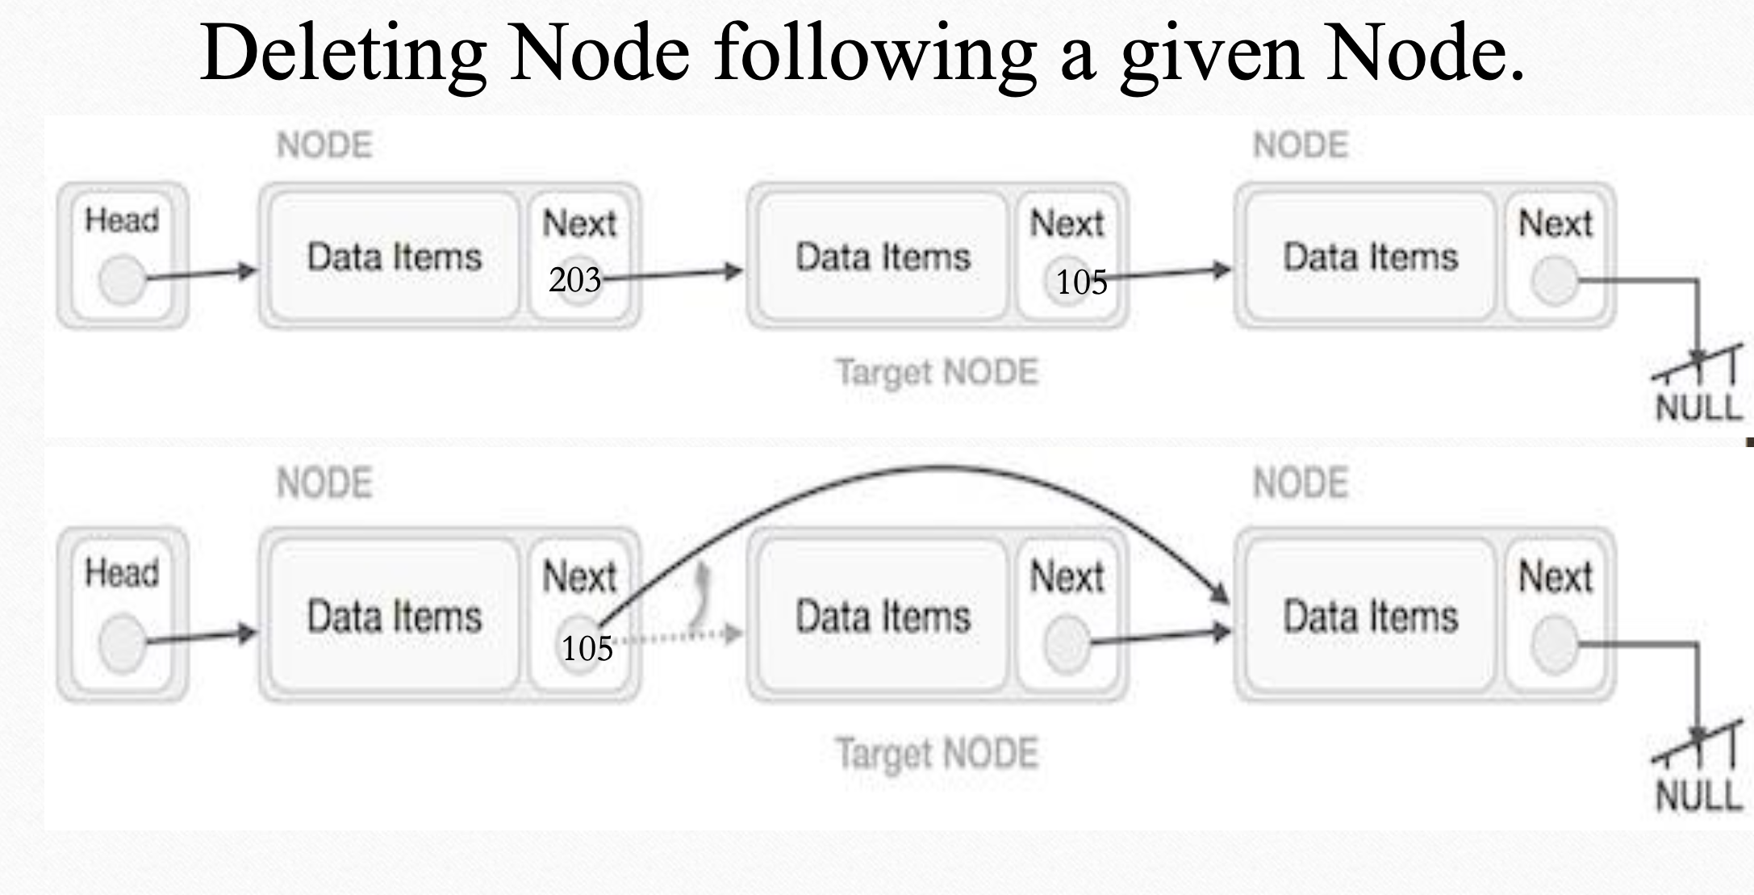

Slide 69
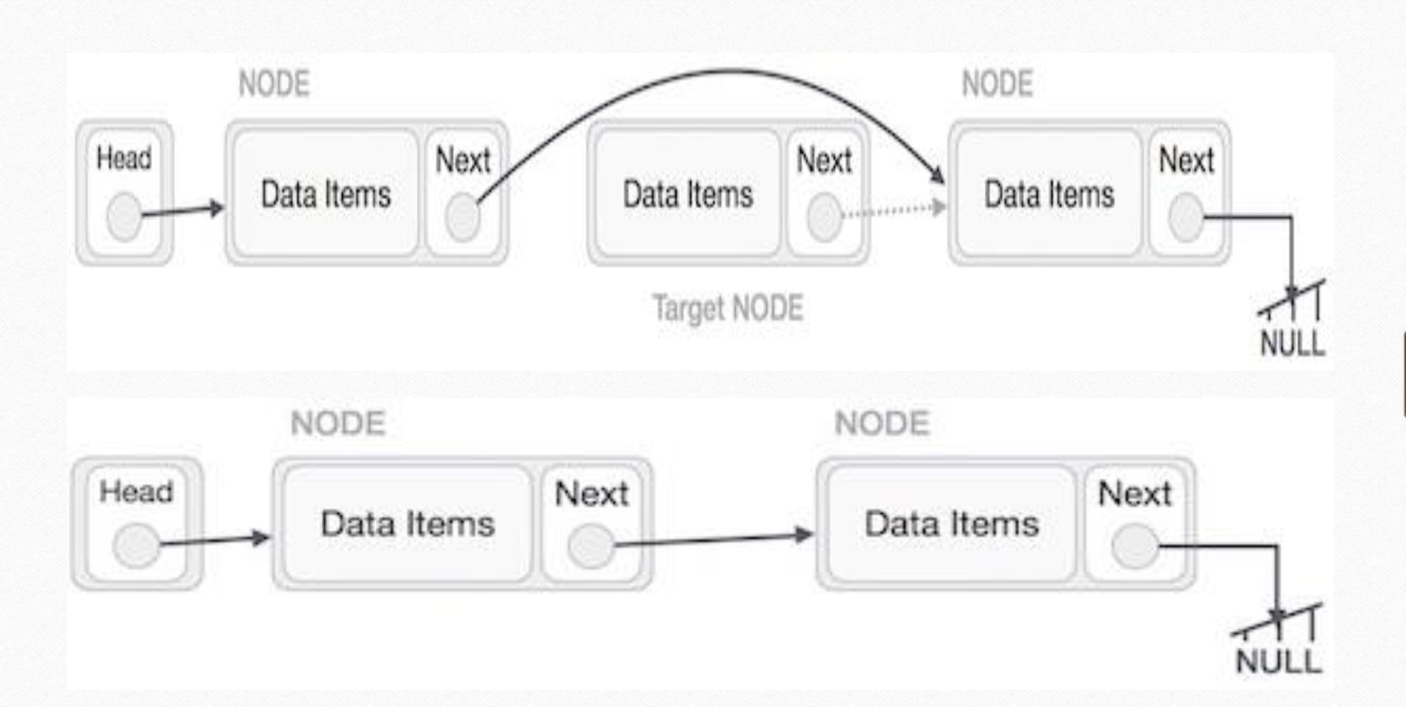

Slide 70
Question Bank
1. What is Linked list? Explain it with suitable example.
2. Explain the representation of linked list in memory.
3. Explain Traversing of linked list with suitable example. 4. Explain searching in Unsorted linked list.
5. Write a short note on overflow and underflow.
6. Write a procedure for inserting element in a linked list 7. Explain deleting node in a linked list.

Slide 71
Thank you!

